Slide 1

Discovering gganimate
@rhetta_chappell

Slide 2


Data Analytics Web Developer Regional Innovation Data Lab Griffith University
@rhetta_chappell

Slide 3
Before we get started….
THANK YOU
RLADIES for the OPPORTUNITY
I am not an expert,
but I love to Learn and share.
Assuming basic understanding
ggplot & Grammar of graphics
@rhetta_chappell

Slide 4
Outline
Brief intro
Key FEATURES
3 Lessons
Resources
Questions
@rhetta_chappell

Slide 5
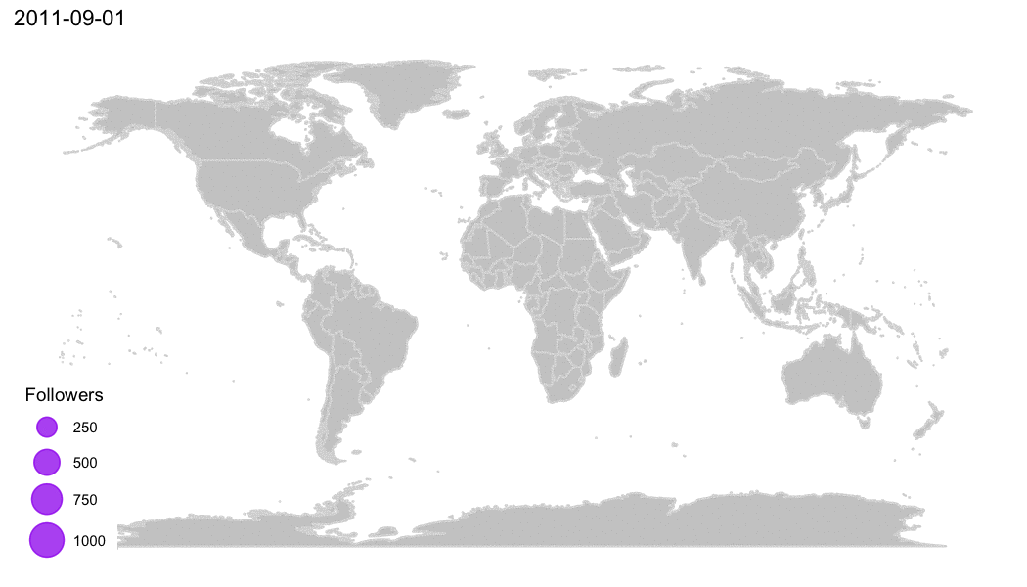
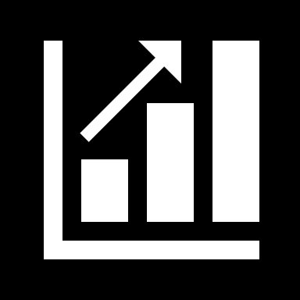
How to install gganimate
gganimate stable version is available on CRAN and can be installed with install.packages('gganimate’)
The latest development version can be installed as follow: devtools::install_github('thomasp85/gganimate').
Animation from: https://d4tagirl.com/2017/05/how-to-plot-animated-maps-with-gganimate

Slide 6
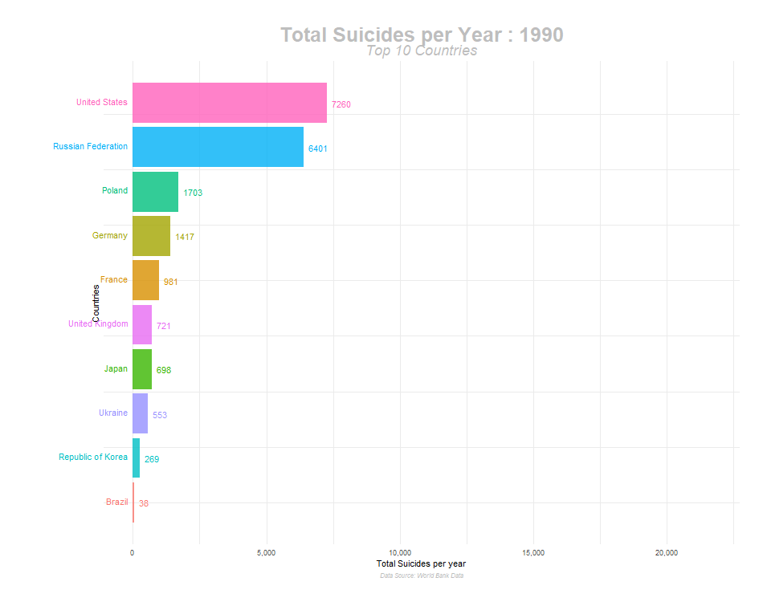
When should you animate?
Data must contain a suitable variable to drive animation e.g.
Changes over time
Changes over iterative/recursive techniques
Changes during a simulation
@rhetta_chappell
https://towardsdatascience.com/how-to-create-plots-with-beautiful-animation-using-gganimate-912f4279b073
Notes:
When telling a data-driven story, few things grab attention more than motion. Our eyes are naturally drawn to bright colors and movement. A good visualization captures the interest of the audience and makes an impression. Fortunately, making such displays has become quite simple with a few easy to use R packages.
Before you start making your charts dance around, you should first ask yourself: Does it makes sense to go through the effort? If you are conducting an exploratory data analysis, a motion graphic may not be worth the time investment. However, if you are giving a presentation, a few well-placed animated graphics can help an audience connect with your topic remarkably better than static counterparts.
The great benefit of animation is that it allows for the expansion of the number of variables you can visualize. The motion of an animated plot is ‘driven’ by a variable in the data set. Some variables lend themselves to better animations than others. For example, animating changes over time is a no-brainer; however, the same approach across categorical variables creates a confusing mess.
The key point here is to highlight important changes in the data over the variable which is driving the animation.

Slide 7
What does gganimate do?
"...gganimate, extends the grammar of graphics as implemented by ggplot2 to include the description of animation. It does this by providing a range of new grammar classes that can be added to the plot object in order to customise how it should change with time".
- https://gganimate.com/
@rhetta_chappell

Slide 8
What does gganimate do?
"When we animate data visualisations we often do it by calculating intermediary data points resulting in a smooth transition between the states represented by the raw data. In gganimate this is done by adding a transition which defines how data should be expanded across the animation frames".
https://www.data-imaginist.com/2018/what-are-we-plotting-what-are-we-animating/
@rhetta_chappell

Slide 9
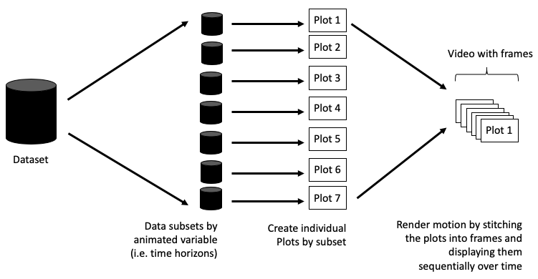
How does gganimate work?
@rhetta_chappell
Image: https://towardsdatascience.com/animating-your-data-visualizations-like-a-boss-using-r-f94ae20843e3
Notes:
When creating animations, the plot does not actually move. Instead, many individual plots are built and then stitched together as movie frames, just like an old-school flip book or cartoon. Each frame is a different plot when conveying motion, which is built using some relevant subset of the aggregate data. The subset drives the flow of the animation when stitched back together.
The more subsets, the smoother your plot will be. This is an important consideration for your animation. If your data is too thin you will only have a few frames, which may not be compelling. In this case, you may be better off using a static panel plot instead of an animation. These can be created in ggplot, for example, using facets. Another option is to expand your dataset using interpolation and the tweener package.

Slide 10
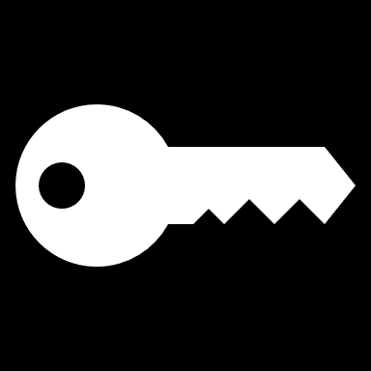
Key features of gganimate:
1. Transitions
transition_ *: this function defines how data should be spread and how it relates to itself over time.
transition_time: the transition length between the states is set to correspond to the actual time difference between them.
transition_reveal: this allows you to let the data gradually disappear.
transition_state: this is used to animate the plots by categorical or discrete variables.
transition_components: allows each graphic element to animate through its own time series – visual components have their own ‘life cycle’
@rhetta_chappell
Notes:
Transitions are functions that interpret the plot data in order to somehow distribute it over a number of frames. We want to calculate the intermediary data states that ensure smooth transitions between states – also referred to as tweening.
Based on the descriptions provided in the documentation and my first simple exploration of gganimate I thought I knew which transition to choose right away but this actually took me a couple of tries and this had to due with the nature of my data. I will talk about this a bit more when I get to the 3 lessons.
transition_components()
This transition allows individual visual components to define their own "life-cycle". Transition_components instead allows each graphic element to animate through its own time series: This means that the final animation will not have any common "state" and "transition" phase as any component can be moving or static at any point in time. uses the group aesthetic of each layer to identify which rows in the input data correspond to the same graphic element and will therefore define stages in time that the element will animate through.

Slide 11
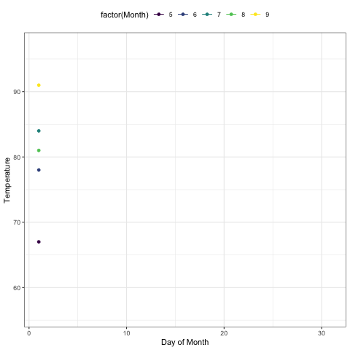
Key features of gganimate:
2. Object permanence
Group aesthetic: Data that have the same group aesthetic are interpreted as being linked across states. The group aesthetic defines how the data in a layer is matched across the animation.
@rhetta_chappell
Notes:
In general, when you make an animation, graphic elements should only transition between instances of the same underlying phenomenon. This sounds complicated but it is more or less the same principle that governs how to draw a line between two observations.
The key is the group aesthetic. You may be familiar with this aesthetic from plotting lines and polygons, but in gganimate it takes a more central place, Data that have the same group aesthetic are interpreted as being linked across states. The group aesthetic defines how the data in a layer is matched across the animation.
This is something I ended up really needing to take advantage of in my animation and I will explain what I mean when I get to the 3 lessons section.

Slide 12
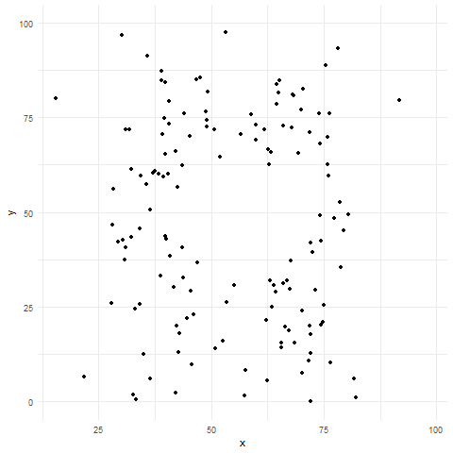
Key features of gganimate:
2. Easing
ease_aes(): it describes how the different aesthetics should be eased during animation. How the animation moves from one value to another.
ease_aes(“cubic-in-out”)
ease_aes(“sine-in-out”)
@rhetta_chappell
https://towardsdatascience.com/animating-your-data-visualizations-like-a-boss-using-r-f94ae20843e3

Slide 13
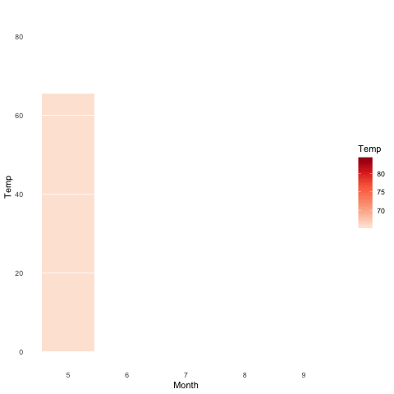
Key features of gganimate:
3. Enter/Exit
enter_*/exit_ *: it is used to determine how new data should be appearing and old data disappearing during the animation process.
enter_fade/exit_shrink/enter_grow/exit_fade
@rhetta_chappell
https://www.datanovia.com/en/blog/gganimate-how-to-create-plots-with-beautiful-animation-in-r/
Notes:
These functions are responsible for modifying the state of appearing (entering) and disappearing (exiting) data, so that the animation can tween from and to the new state.

Slide 14
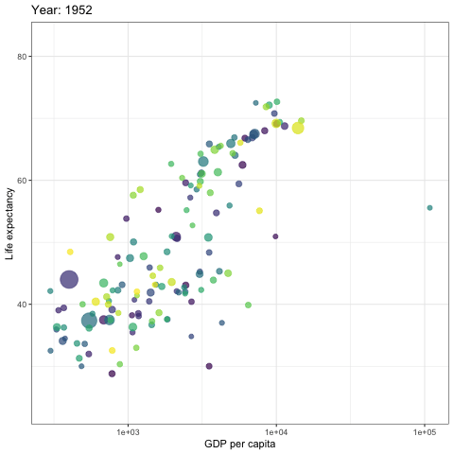
Key features of gganimate:
2. View
view_ *: It is used to define how the axes should change along with the animation.
view_follow(fixed_y=TRUE): This means that the y_axis would be fixed when the animation is running.
view_follow(fixed_x=TRUE) : the x-axis would be fixed as the animation runs.
@rhetta_chappell

Slide 15
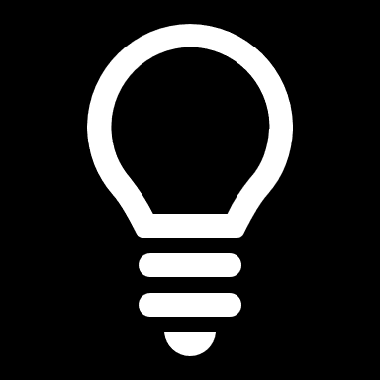
Lesson #1
Have a clear plan:
Get to know your data
Sketch out the different frames/ states for your animation (remember the way gganimate works it is like an old school cartoon flip book)
Read documentation or find a similar online example
@rhetta_chappell

Slide 16
Lesson #3
Transition_time() doesn’t work if you have repeated/ non-continuous dates/times.
Project brief – illustrate changes in price within a set series of price surges geographically and temporally
transition_time() but it didn’t work due to non unique time/dates
transition_components – to iterate throught he unique time series for each of the price surges but this wasn’t quite right
transition_reveal – was the winner in the end for what I needed to reveal data gradually you can also set cumulative = TRUE in a few of the other transition_* to build data up on your plot.
@rhetta_chappell

Slide 17
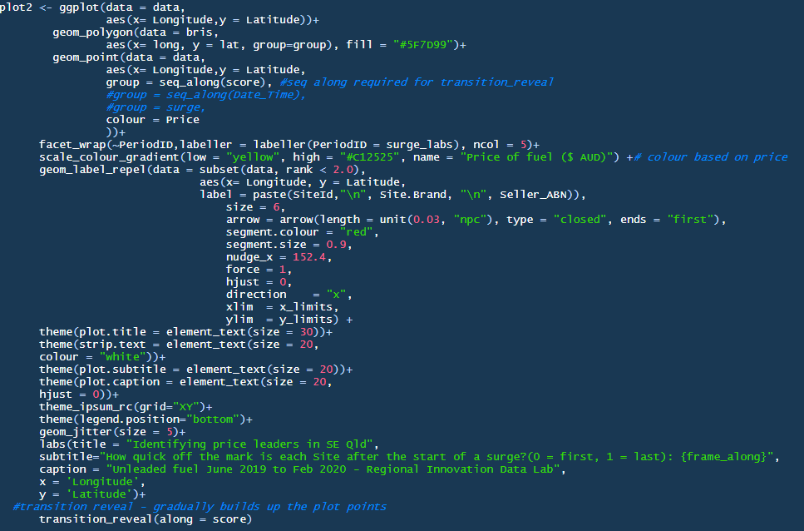
Lesson #3
When using transition_reveal to have data gradually appear use the group aesthetic and you can keep points (layer/build up the plot) by giving them a unique group using:
group = seq_along(grouping_var)
@rhetta_chappell

Slide 18
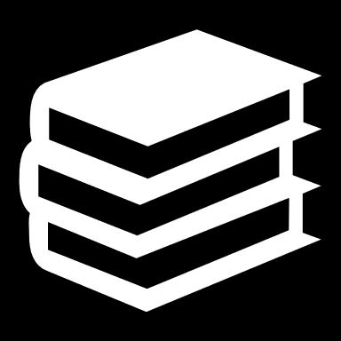
Resources
Getting Started:
GGplot:
https://ggplot2.tidyverse.org/
Grammar of graphics:
https://amzn.to/2fncG50
GGanimate:
https://gganimate.com/
R & RLadies:
https://rladies.org/
Blogs/Tutorials:
https://www.datanovia.com/en/blog/gganimate-how-to-create-plots-with-beautiful-animation-in-r/
https://towardsdatascience.com/animating-your-data-visualizations-like-a-boss-using-r-f94ae20843e3
https://towardsdatascience.com/how-to-create-plots-with-beautiful-animation-using-gganimate-912f4279b073
@rhetta_chappell

Slide 19
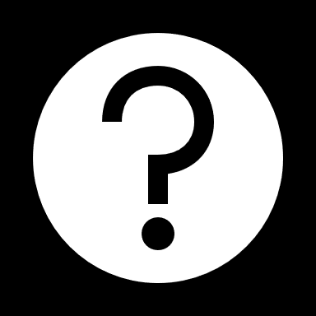
Thank you!
How to get in touch:
www.ridl.com.au
r.chappell@Griffith.edu.au
Twitter: @rhetta_chappell

